Slide 1

Puducherry Technological University
Department of Information Technology
Economical MobiWise Insight System
(EMWIS)
IT225 - Software Engineering Laboratory
Submitted By
Mr. Arjun Christopher Reg. no.: 2201112007
Ms. Bhuvanalakshmi Reg. no.: 2201112009
Date: 08-05-2025

Slide 2
Agenda
Abstract
Motivation
Project Objective
Literature Survey
Inference from Literature Survey
Proposed High-Level Architecture
Description of EMWIS
Decomposition of EMWIS
Module – I: Mobile Recommendations and AJAX
Module – II: AI and Cloud Integration
Module – III: Cart and Order Management
Sample Input and Output Screenshots
Results and Discussion
Conclusion and Future Enhancement
References

Slide 3
Abstract
In today’s rapidly evolving mobile landscape, consumers face increasing difficulty in making smart purchasing decisions. With new models launching almost weekly, and prices shifting in real-time due to fierce competition and dynamic marketing strategies, buyers often feel overwhelmed.
The abundance of specifications, brand variants, and feature sets adds further complexity, making it hard to identify the best value.
To address this, real-time market analysis, automated price tracking, and smart comparison tools have become critical. By integrating cloud computing and API-driven data aggregation, users can now access live updates on pricing trends and mobile features.
However, simply presenting raw data is no longer enough. The future demands a system that blends automation, accuracy, and adaptability, transforming scattered insights into meaningful, user-friendly decisions. A truly intelligent solution must empower every user, regardless of technical background, to shop with confidence and clarity.

Slide 4
Motivation
In the current mobile market, consumers face significant challenges when selecting the right device due to inconsistent pricing, an overwhelming variety of specifications, and constantly evolving user needs. Promotions driven by dynamic pricing algorithms and the lack of meaningful comparison tools further complicate decision-making, often leaving buyers confused and dissatisfied.
Existing platforms typically focus only on superficial comparisons and fail to offer in-depth evaluations based on critical factors such as feature durability, performance-to-price ratio, and genuine user satisfaction. This gap highlights the urgent need for a smarter, more comprehensive solution.
The motivation behind this project is to develop an intelligent, real-time, user-centric platform that goes beyond basic search and comparison. The system aims to provide personalized mobile recommendations, dynamic price alerts, order tracking, and post-purchase services like easy cancellation and updates. By integrating advanced technologies such as cloud computing, data aggregation, and behavior-driven analytics, the project aspires to empower every user to make confident, well-informed, and efficient mobile purchasing decisions.

Slide 5
Project Objective
EMWIS aims to develop a centralized and dynamic mobile pricing insight system that empowers users to make intelligent, data-driven purchasing decisions.
By integrating multiple data sources, it provides a comprehensive price comparison experience and smart recommendations tailored to user preferences.
Supports personalized comparison outcomes through shareable links.
Real-time price tracking with notifications via Email, SMS, and WhatsApp.
Secure, session-based cart and checkout module with structured address input.
Users can monitor order status in real time and cancel orders via a confirmation-based interface.
A role-based admin portal offers full CRUD functionalities for:
Designed with scalability and performance optimization in mind, supporting chatbot integration and background job scheduling.

Slide 6
Literature Survey
S. No | Title of Paper | Journal Title & Year of Publication | Technical Description | Research Gap
[1] | AI-Driven Predictive Analytics in Retail: A Review of Emerging Trends and Customer Engagement Strategies | International Journal of Management & Entrepreneurship Research, 2024 | Discusses the integration of machine learning algorithms, natural language processing, and computer vision to forecast consumer behavior and optimize inventory in the retail sector. | Lacks real-time market trend integration for dynamic pricing adjustments.
[15] | Pricing Cloud IaaS Computing Services | Journal of Cloud Computing: Advances, Systems and Applications, 2020 | Evaluates pricing strategies for Infrastructure-as-a-Service (IaaS) by analyzing models inspired by Amazon EC2, focusing on optimizing provider revenue through various pricing schemes. | Does not include personalized recommendations based on individual user preferences and usage patterns.
[2] | AI-Driven Pricing Algorithms for Efficient Inventory and Cost Management in Retail | The European Journal of Research and Development, 2024 | Presents the development of AI software utilizing advanced machine learning techniques to analyze historical sales data, inventory levels, and market conditions for real-time pricing adjustments. | Does not incorporate real-time analytics and consumer preferences for personalized pricing strategies.

Slide 7
Inference from Literature Survey
Existing AI-driven pricing models largely depend on historical data like past sales, seasonal trends, and competitor pricing. While useful for general insights, they fail to adapt to real-time changes caused by flash sales, new launches, and promotional events. This limits their effectiveness, often resulting in outdated or suboptimal recommendations.
Cloud-based pricing strategies offer scalability and faster data processing, but many still lack personalization, applying uniform pricing logic without considering individual user behavior or preferences. In today’s user-driven market, this reduces engagement and lowers conversion rates.
To bridge these gaps, a new system is needed—one that integrates real-time market analysis, AI-powered dynamic pricing, and behavior-driven personalization. By continuously monitoring live market trends and adapting recommendations instantly, such a platform would empower consumers to make more confident decisions and help businesses offer competitive, up-to-the-minute insights.

Slide 8
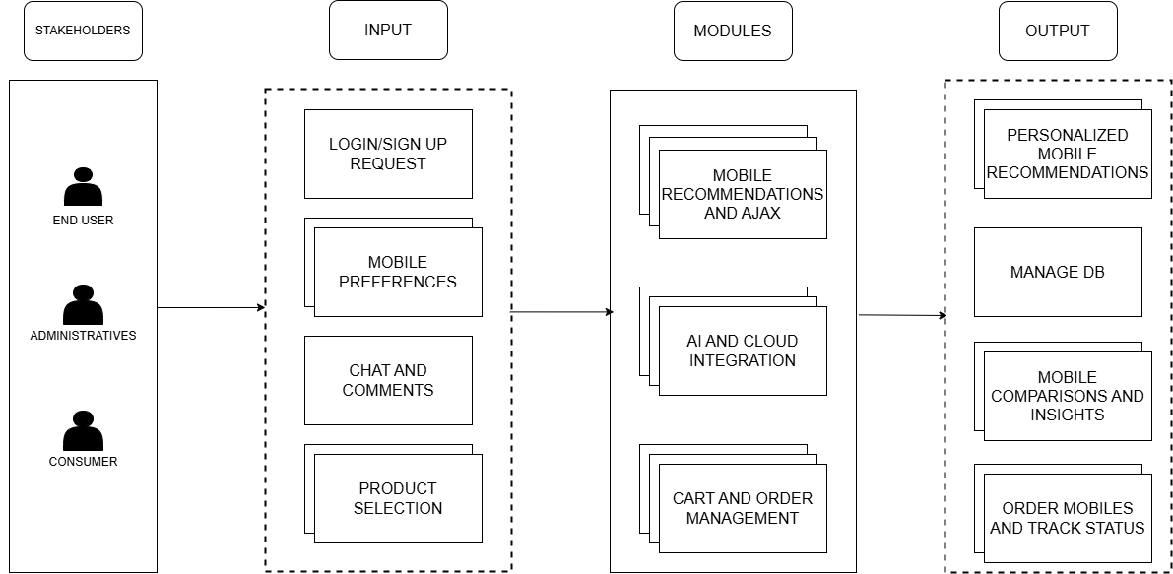
Proposed High-Level Architecture

Slide 9
Description of EMWIS
Based on the findings from the literature survey, the proposed EMWIS project addresses key limitations in mobile shopping by offering real-time price tracking, intelligent comparisons, personalized recommendations, and full order management through an integrated web-based platform.
8 Core Objectives:
Implement real-time data synchronization using Flask and PyODBC.
Develop smart comparison algorithms for detailed feature analysis.
Enable AI-driven personalized recommendations based on user behavior.
Set up automated price drop tracking and historical price logging.
Integrate multi-channel notifications (Email, SMS, WhatsApp).
Build a secure cart, checkout, and invoice generation system.
Manage complete order lifecycle: tracking, cancellation, confirmation.
Provide a modular admin panel with role-based access controls.
Conduct full testing (unit, integration, UAT) for system validation.

Slide 10
Decomposition of EMWIS

Slide 11
Module - I
Mobile Recommendations and AJAX

Slide 12
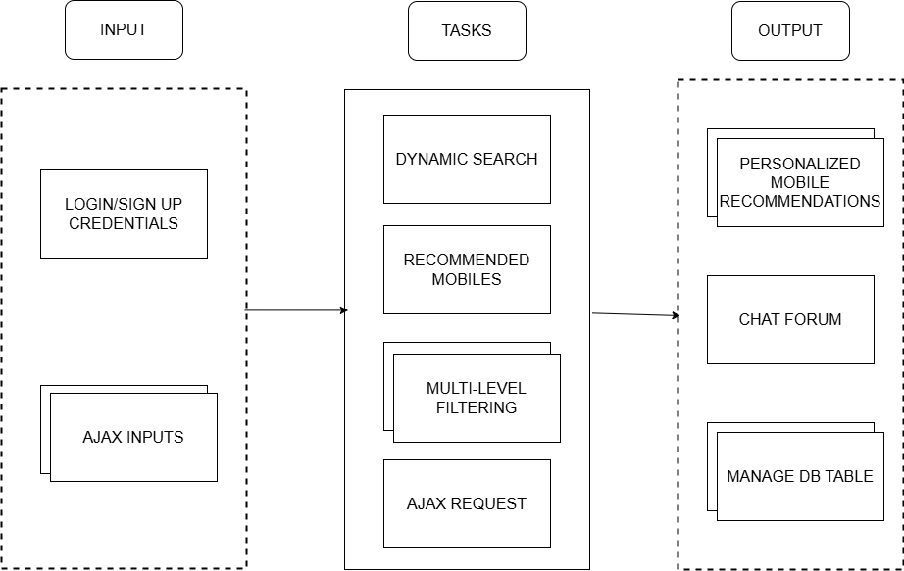
Mobile Recommendations and AJAX
Task 1: Dynamic Search Implements user authentication and personalized search experiences, with secure session tracking and user interaction logging.
Task 2: Recommended Mobiles Recommends mobiles based on search and filter patterns. Suggestions are dynamically updated on the homepage based on user behavior.
Task 3: Multi-Level Filtering Enables filtering by brand, price, and features using dynamic AJAX-based multi-category filters, optimized for fast responses.
Task 4: AJAX Request Handling Handles real-time search requests and dynamic updates without page reloads. Includes validation and error handling for seamless user experience.

Slide 13
Module - II
AI and Cloud Integration

Slide 14
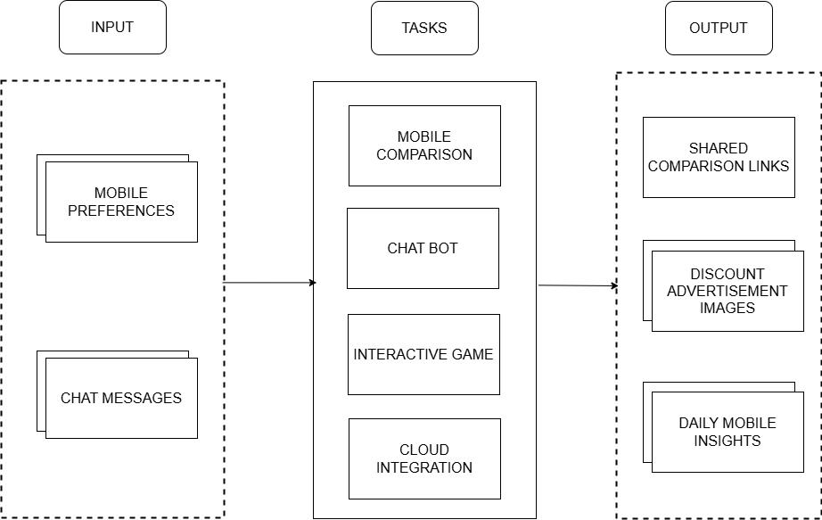
AI and Cloud Integration
Task 1: Mobile Comparison Captures user preferences and generates comparative analyses of mobile features. Enables dynamic comparison links for easy sharing and decision-making.
Task 2: Chat Bot Processes user messages to detect intents and provide real-time mobile recommendations. Manages FAQs and troubleshooting via intelligent chatbot responses.
Task 3: Interactive Game Engages users with a mobile-themed game. Tracks achievements via cloud storage and dynamically displays rewards or offers based on performance.
Task 4: Cloud Integration Ensures secure storage of comparisons, chats, and game data in the cloud. Fetches daily mobile news from external APIs and maintains real-time data sync across modules.

Slide 15
Module - III
Cart and Order Management

Slide 16
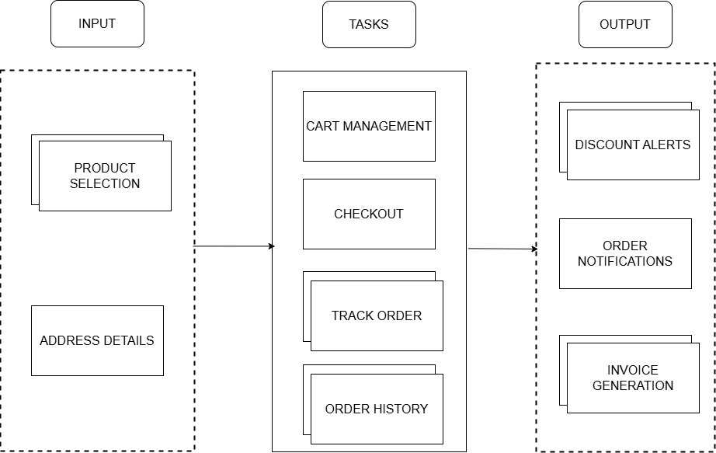
Cart and Order Management
Task 1: Cart Management Enables users to add, update, or remove items from the cart with quantity control and preferences. Persistent cart storage ensures continuity for logged-in users across sessions.
Task 2: Checkout Captures billing/shipping details and integrates secure payment processing. Validates user information to ensure smooth and error-free order placement.
Task 3: Track Order Provides live updates on order status—from confirmation to delivery. Sends real-time notifications about shipping progress, delays, or issues.
Task 4: Order History Maintains records of all past orders with invoice generation and quick reorder functionality, enhancing user convenience and satisfaction.

Slide 17
Sample Input and Output Screenshots

Slide 18
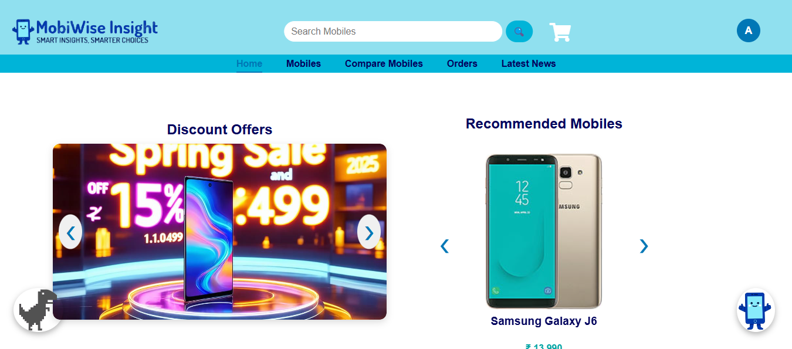
Module - I : Home Page

Slide 19
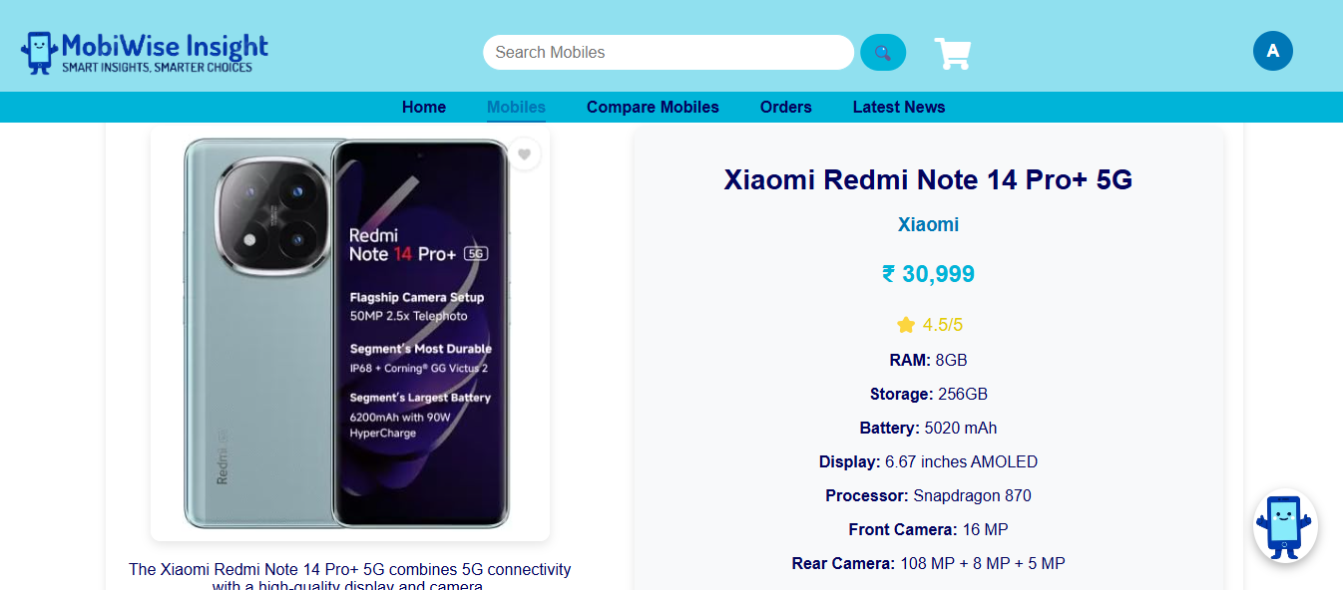
Module – I: Mobile Specifications

Slide 20
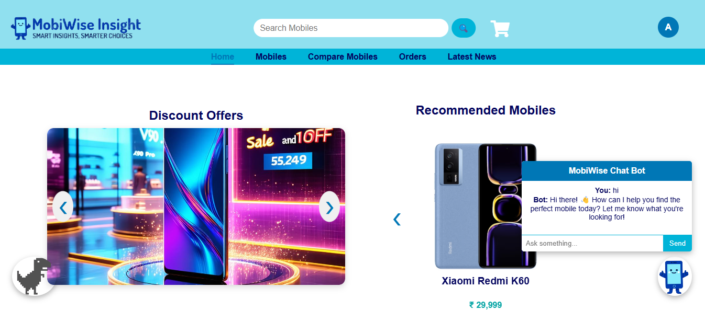
Module – II: Chat Bot

Slide 21
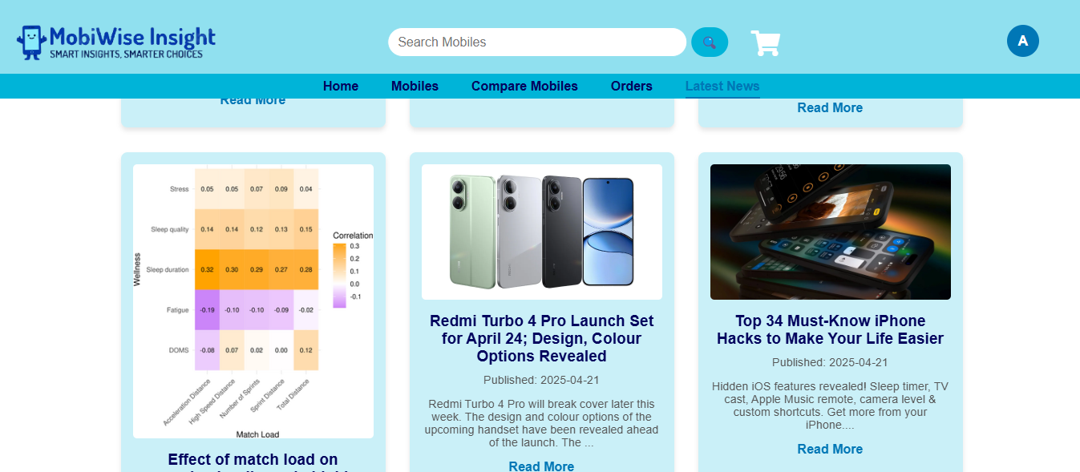
Module – II: Latest Mobile News

Slide 22
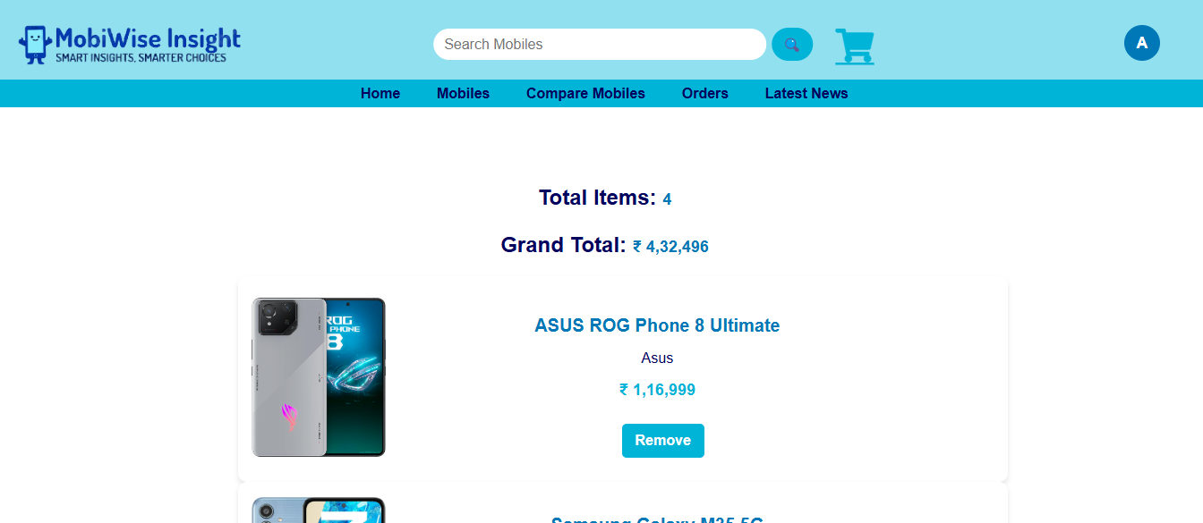
Module – III: Cart System

Slide 23

Module – III: Order Invoice

Slide 24
Results and Discussion
Developed and deployed a real-time mobile price tracking and analysis engine with personalized recommendations.
Built dynamic UI components: comparison dashboards, cart/checkout systems, order tracking, and chatbot interaction.
Integrated multi-channel notifications (WhatsApp, Email, SMS) for price drops, order updates, and discounts.
Automated time-sensitive tasks using cloud-based scheduling (APScheduler) to boost operational efficiency.
Implemented secure JWT-based user sessions with persistent login for a seamless user experience.
Deployed modular, role-based admin panels for real-time backend management.
Delivered AI-powered comparison insights to enhance decision-making and purchase satisfaction.
Achieved high performance and reliability through optimized database queries, session management, and caching.

Slide 25
Conclusion and Future Enhancement
The EMWIS offers a comprehensive, intelligent, and user-centric platform that empowers consumers to make timely, well-informed mobile purchasing decisions. By integrating real-time analytics, personalized recommendations, automated discount notifications, and secure order management, EMWIS effectively overcomes the limitations of existing mobile shopping tools.
Future Enhancements:
Expand integration with more e-commerce APIs for a wider device catalog.
Enhance AI recommendation models for greater accuracy and relevance.
Improve chatbot intelligence for smarter queries and guided shopping support.
Launch a cross-platform mobile application for greater accessibility.
Implement user analytics for adaptive personalization and deeper engagement.

Slide 26
References
[1] AI-Driven Predictive Analytics in Retail: A Review of Emerging Trends and Customer Engagement Strategies – John Smith, Michael Brown. International Journal of Management & Entrepreneurship Research, 2024. Available at: https://ijmer.com/ai-retail-2024
[2] AI-Driven Pricing Algorithms for Efficient Inventory and Cost Management in Retail – Mark Wilson, Lisa Green. The European Journal of Research and Development, 2024. Available at: https://ejrd.com/ai-pricing-2024
[3] Amazon. Available at: https://www.amazon.com
[4] ChatGPT. OpenAI conversational AI model. Available at: https://chat.openai.com
[5] Coolors Color Palette Generator. UI color scheme reference. Available at: https://coolors.co
[6] Currents News API – For real-time mobile-related news. Available at: https://currentsapi.services
[7] Disqus Documentation – Embedded comment system for websites. Available at: https://disqus.com

Slide 27
References (cont..)
[8] GNews API – Global news API used for fetching mobile-related news. Available at: https://gnews.io
[9] Google Gemini API – AI-powered suggestion engine used for mobile comparison. Available at: https://ai.google.dev
[10] GSMArena – Mobile Comparison Platform. Available at: https://www.gsmarena.com
[11] Hugging Face API – AI model hosting and inference API used for generating mobile advertisement images. Available at: https://huggingface.co
[12] Javatpoint – Flask Tutorial. Web framework reference. Available at: https://www.javatpoint.com/flask
[13] NewsAPI – RESTful news API to retrieve mobile-related articles. Available at: https://newsapi.org
[14] Oracle Official Documentation – Oracle database SQL and PL/SQL references. Available at: https://docs.oracle.com

Slide 28
References (cont..)
[15] Pricing Cloud IaaS Computing Services – David Johnson, Emily Carter. Journal of Cloud Computing: Advances, Systems and Applications, 2020. Available at: https://cloudcomputing-journal.com/pricing-iaas
[16] pywhatkit GitHub Repository – Python module for WhatsApp messaging automation. Available at: https://github.com/Ankit404butfound/pywhatkit
[17] W3Schools – HTML/CSS Tutorials. Web development reference. Available at: https://www.w3schools.com
[18] Yahoo Finance API – Used for tracking mobile market trends and competitor pricing. Available at: https://www.yahoofinanceapi.com
[19] YCharts – Financial data and analytics platform for evaluating tech market performance. Available at: https://ycharts.com
[20] YouGov – Research and analytics platform providing consumer insights for mobile trends. Available at: https://yougov.com
[21] ZDNet – Tech news site referenced for mobile industry trends. Available at: https://www.zdnet.com

Slide 29
Thank you

